Slide 1
ARRAYS
Computer Engineering Department
Java Course
Assoc. Prof. Dr. Ahmet Sayar
Kocaeli University - Fall 2019

Slide 2
Introduction to Arrays
An array is an object used to store a (possibly large) collection of data.
All the data stored in the array must be of the same type.
An array object has a small number of predefined methods.

Slide 3
Introduction to Arrays, cont.
Sometimes you want to know several things about a collection of data:
the average
the number of items below the average
the number of items above the average
etc.
This requires all the items to be stored as variables of one kind or another.

Slide 4
ARRAYS
You can make an array of any type
int, double, String
All elements of an array must have the same type
int[] values = new int[5];
int[] values = { 12, 24, -23, 47, 22 };
values[1] = ?
values[values.length] = ?
int length = values.length; // not lenght or length()!!!

Slide 5
Array Details
Syntax for creating an array
Base_Type[] Array_Name = new Base_Type[Length];
Arrays of primitive types or complex types
Example
int[] pressure = new int[100];
or
int[] pressure;
pressure = new int[100];

Slide 6
Indices and length
The indices of an array start with 0 and end with Array_Name.length-1.
When a for loop is used to step through an array, the loop control variable should start at 0 and end at length-1.
Example
for (lcv = 0; lcv < temperature.length; index++)

Slide 7
Initializing Arrays
An array can be initialized at the time it is declared.
example
double[] reading = {3.3, 15.8, 9.7};
The size of the array is determined by the number of values in the initializer list.

Slide 8
Arguments for the Method main
Recall the heading for method main:
public static void main(String[] args)
Method main takes an array of String values as its argument.
A default array of String values is when you run a program.

Slide 9
Arguments for the Method main, cont.
Alternatively, an array of String values can be provided in the command line.
Example
java TestProgram Mary Lou
args[0] is set to “Mary”
args[1] is set to “Lou”
System.out.println(“Hello “ + args[0] +
“ “ + args[1]);
prints Hello Mary Lou.

Slide 10
Use of = and == with Arrays
The assignment operator ‘=‘and the equality operator ‘==’, when used with arrays, behave the same as when used with other objects.
The assignment operator creates an alias, not a copy of the array.
The equality operator determines if two references contain the same memory address, not if two arrays contain the same values.

Slide 11
Making a Copy of an Array
1.way
int[] a = new int[50];
int[] b = new int[50];
...
for (int j = 0; j < a.length; j++)
b[j] = a[j];
2.way
Clone()
b = a.clone();

Slide 12
Determining the “Equality” of Two Arrays, cont.
A while loop can be used.
A boolean variable match is set to true.
Each element in the first array is compared to the corresponding element in the second array.
If two elements are different, match is set to false and the while loop is exited.
Otherwise, the loop terminates with match still set to true.

Slide 13
Sorting Arrays
Sometime we want numbers in an array sorted from smallest to largest, or from largest to smallest.
Sometimes we want the strings referenced by an array to be in alphabetical order.
Sorting techniques typically are easy to adapt to sort any type that can be ordered.

Slide 14
Selection Sort, cont.
Selection sort begins by finding a smallest item in the array and swapping it with the item in a[0].
Selection sort continue by finding a smallest item in the remainder of the array and swapping it with the next item in array a.
Selection sort terminates when only one item remains.

Slide 15
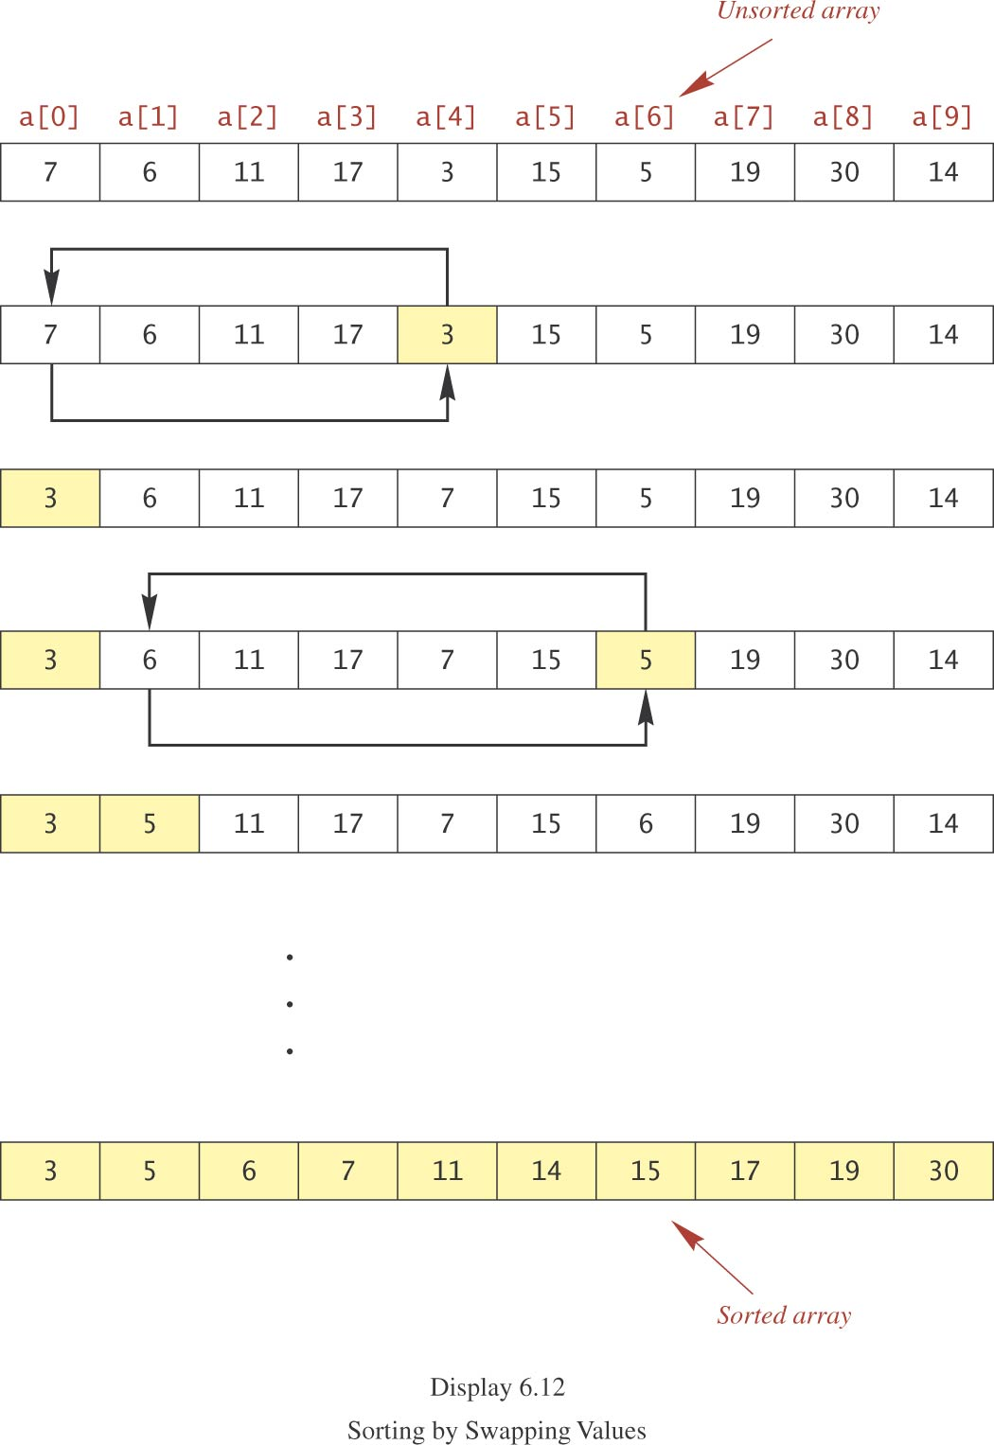
Selection Sort, cont.

Slide 16
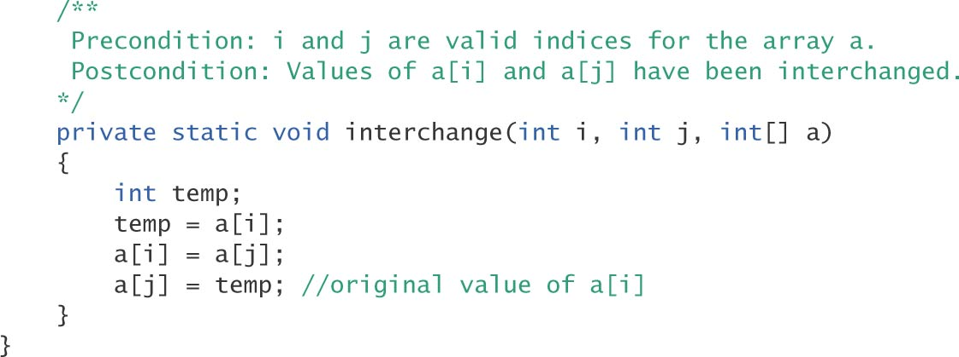
Swapping Elements
To swap two elements a[i] and a[j], one of them must be saved temporarily.

Slide 17
Introduction to Multidimensional Arrays
An array with more than one index sometimes is useful.
Example: savings account balances at various interest rates for various numbers of years
columns for interest rates
rows for years
This two-dimensional table calls for a two-dimensional array.

Slide 18
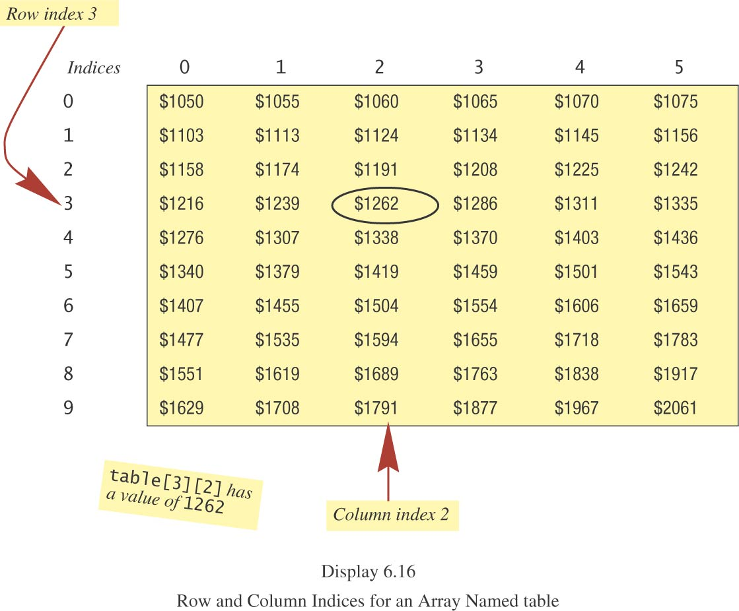
Introduction to Multidimensional Arrays, cont.

Slide 19
Multidimensional-Array Basics
example declaration
int[][] table = new int [10][6];
or
int[][] table;
table = new int[10][6];
The number of bracket pairs in the declaration is the same as the number of indices.

Slide 20
Multidimensional-Array Basics, cont.
Syntax
Base_Type[]…[] Array_Name =
new Base_Type[Length_1]…[Length_n];
Examples
char[][] page = new char [100][80];
double[][][] threeDPicture =
new double[10][20][30];
SomeClass[][] entry = new SomeClass[100][80];

Slide 21
Multidimensional-Array Basics, cont.
Nested for loops can be used to set the values of the elements of the array and to print the values of the elements of the array.

Slide 22
2-dim Arrays
int [][] test = new int [][];
Error: Array dimension is missing
int [][] test = new int [3][];
Raw number is 3, but column number is not defined yet – OK?
System.out.println(test.length); // ??
test = new int [3][2];
System.out.println(test[1].length); // ??
Notes:
3
2

Slide 23
Decleration and Initialization in one line
int[] test = new test[2][2];
test[0][0]=0;
test[0][1]=1;
test[1][0]=2;
test[1][1]=3;
OR
int[] test = {{0,1},{2,3}};

Slide 24
Ragged Arrays
Since a two-dimensional array in Java is an array of arrays, each row can have a different number of elements (columns).
Arrays in which rows have different numbers of elements are called ragged arrays.

Slide 25
Ragged Arrays, cont.
Example
int[][] b = new int[3][];
b[0] = new int[5];
b[1] = new int[7];
b[2] = new int[4];

Slide 26
An Alternative to Arrays -ArrayList Class-
Implemented by using Array Class
ArrayList
No need to pre-define the size
ArrayList<String> list = new ArrayList<String>();
list.add("a");
for (int i = 0; i < list.size(); i++) {
System.out.println("----- "+list.get(i));
}
Notes:
ArrayList and LinkedList both implements List interface and maintains insertion order. Both are non synchronized classes.
But there are many differences between ArrayList and LinkedList classes that are given below.
ArrayList internally uses dynamic array to store the elements. ---- LinkedList internally uses doubly linked list to store the elements.
Manipulation with ArrayList is slowbecause it internally uses array. If any element is removed from the array, all the bits are shifted in memory. ---- Manipulation with LinkedList is faster than ArrayList because it uses doubly linked list so no bit shifting is required in memory.
ArrayList class can act as a list only because it implements List only. ---- LinkedList class can act as a list and queue both because it implements List and Deque interfaces.
ArrayList is better for storing and accessing data. ---- LinkedList is better for manipulating data.

Slide 27
ArrayList - I
An ArrayList is a one-dimensional array.
An ArrayList holds only objects, not primitive values like int, double, char or boolean.
When you declare a standard array, you have to tell Java a fixed number of memory locations that you want the array to contain.
When you declare an ArrayList, you don’t have to tell Java how much storage space you need. It will resize itself when needed.

Slide 28
ArrayList - II
ArrayList <Integer> nums = new ArrayList <Integer> ( );
ArrayList <String> names = new ArrayList <String> ( );
ArrayList <Student> students = new ArrayList <Student> ( );
ArrayList <Integer> nums = new ArrayList <Integer> (1000);
The ArrayList API says that all of the above ArrayLists will be constructed with an initial capacity of ten.
an ArrayList holds only objects, not primitive values like int, double, char or boolean. But in particular Java has the Integer and Double classes so you can place numbers in an ArrayList

Slide 29
Generic or Raw ArrayList
ArrayList <String> names = new ArrayList <String> ( );
ArrayList names = new ArrayList ( );
Difference:
In the second one, you could put all kinds of objects in the same ArrayList, but care had to be taken to make sure only one kind of object was placed in a list. You can still declare and instantiate a raw ArrayList, like the following, but most compilers will “complain” and at least give you a warning if you are using Java 1.5 or higher.

Slide 30
Advantages of ArrayList
Operations are much much easier and less complex for:
traversing an ArrayList (accessing each element to print or perform an operation on it)
insertions anywhere in the ArrayList
removals anywhere in the ArrayList
searching an ArrayList
An ArrayList tracks its own logical size and grows or shrinks automatically depending on the number of elements it has

Slide 31
ArrayList API – Some samples
add(value) | appends value at end of list
add(index, value) | inserts given value just before the given index, shifting subsequent values to the right
clear() | removes all elements of the list
indexOf(value) | returns first index where given value is found in list (-1 if not found)
get(index) | returns the value at given index
remove(index) | removes/returns value at given index, shifting subsequent values to the left
set(index, value) | replaces value at given index with given value
size() | returns the number of elements in list
toString() | returns a string representation of the list such as "[3, 42, -7, 15]"

Slide 32
ArrayList API – Some samples
clear​() | Removes all of the elements from this list.
clone​() | Returns a shallow copy of this ArrayList instance.
contains​(Object o) | Returns true if this list contains the specified element.
ensureCapacity​(int minCapacity) | Increases the capacity of this ArrayList instance, if necessary, to ensure that it can hold at least the number of elements specified by the minimum capacity argument.
isEmpty​() | Returns true if this list contains no elements.
lastIndexOf​(Object o) | Returns the index of the last occurrence of the specified element in this list, or -1 if this list does not contain the element.
toArray​() | Returns an array containing all of the elements in this list in proper sequence (from first to last element).

Slide 33
Sample code
// Creating an ArrayList of String
List<String> animals = new ArrayList<>();
// Adding new elements to the ArrayList
animals.add("Lion");
animals.add("Tiger");
animals.add("Cat");
animals.add("Dog");
System.out.println(animals);
// Adding an element at a particular index in an ArrayList
animals.add(2, "Elephant");
System.out.println(animals);
Notes:
# Output
[Lion, Tiger, Cat, Dog]
[Lion, Tiger, Elephant, Cat, Dog]

Slide 34
public class AccessElementsFromArrayListExample {
public static void main(String[] args) {
List<String> topCompanies = new ArrayList<>();
// Check if an ArrayList is empty
System.out.println("Is the topCompanies list empty? : " + topCompanies.isEmpty());
topCompanies.add("Google");
topCompanies.add("Apple");
topCompanies.add("Microsoft");
topCompanies.add("Amazon");
topCompanies.add("Facebook");
// Find the size of an ArrayList
System.out.println("Here are the top " + topCompanies.size() + " companies in the world");
System.out.println(topCompanies);
// Retrieve the element at a given index
String bestCompany = topCompanies.get(0);
String secondBestCompany = topCompanies.get(1);
String lastCompany = topCompanies.get(topCompanies.size() - 1);
System.out.println("Best Company: " + bestCompany);
System.out.println("Second Best Company: " + secondBestCompany);
System.out.println("Last Company in the list: " + lastCompany);
// Modify the element at a given index
topCompanies.set(4, "Walmart");
System.out.println("Modified top companies list: " + topCompanies);
}
}
Notes:
# Output
Is the topCompanies list empty? : true
Here are the top 5 companies in the world
[Google, Apple, Microsoft, Amazon, Facebook]
Best Company: Google
Second Best Company: Apple
Last Company in the list: Facebook
Modified top companies list: [Google, Apple, Microsoft, Amazon, Walmart]

Slide 35
An Alternative to Arrays - Vector Class-
Implemented by using Array Class
The class Vector can be used to implement a list, replacing a simple array
The size of a Vector object can grow/shrink during program execution
The Vector will automatically grow to accommodate the number of elements you put in it
Vectors can hold only Objects and not primitive types (eg, int )

Slide 36
class Vector (continued)
The class Vector is contained in the package java.util
Programs must include either:
import java.util.*;
import java.util.Vector;

Slide 37
Vector Declaration
Declare/initialize
Vector<Student> students = new Vector<Student>();
The syntax <…> is used to declare the type of object that will be stored in the Vector
If you add a different type of object, an exception is thrown
Not strictly necessary, but highly recommended (compiler warning)
Only stores Objects – does not have indexing as in Arrays

Slide 38
Vector Size/Capacity
The size of a vector is the number of elements
The capacity of a vector is the maximum number of elements before more memory is needed
If size exceeds capacity when adding an element, the capacity is automatically increased
Declares a larger storage array
Copies existing elements, if necessary
Growing the capacity is expensive!
By default, the capacity doubles each time

Slide 39
Setting Initial Capacity
If you know you will need a large vector, it may be faster to set the initial capacity to something large
Vector<Student> students = new Vector<Student>(1000);

Slide 40
Size and capacity
Get the current size and capacity:
Vector<Student> students = new Vector<Student>(1000);
students.size(); // returns 0
students.capacity(); // returns 1000
Setting size and capacity:
// adds null elements or deletes elements if necessary
students.setSize(10);
// increases capacity if necessary
students.ensureCapacity(10000);

Slide 41
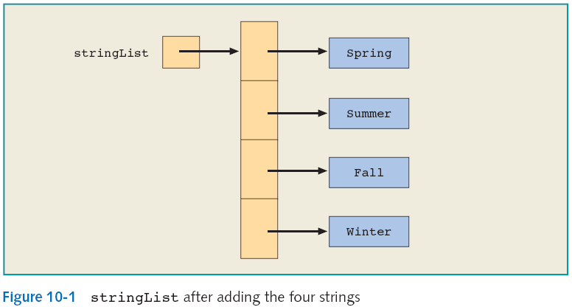
Adding Elements
Vector<String> stringList = new Vector<String>();
stringList.add("Spring");
stringList.add("Summer");
stringList.addElement("Fall");
stringList.addElement("Winter");
add and addElement
have identical functionality

Slide 42
Accessing Elements
stringList.get(0); // “Spring”
stringList.get(3); // “Winter”
stringList.get(4); // ArrayIndexOutOfBounds Exception

Slide 43
Vector API – Some samples
add(value) | appends value at end of list
add​(int index, E element) | Inserts the specified element at the specified position in this Vector.
add​(E e) | Appends the specified element to the end of this Vector.
addAll​(int index, Collection<? extends E> c) | Inserts all of the elements in the specified Collection into this Vector at the specified position.
addAll​(Collection<? extends E> c) | Appends all of the elements in the specified Collection to the end of this Vector, in the order that they are returned by the specified Collection's Iterator.
addElement​(E obj) | Adds the specified component to the end of this vector, increasing its size by one.
capacity​() | Returns the current capacity of this vector.

Slide 44
Vector API – Some samples
clear​() | Removes all of the elements from this Vector.
clone​() | Returns a clone of this vector.
contains​(Object o) | Returns true if this vector contains the specified element.
containsAll​(Collection<?> c) | Returns true if this Vector contains all of the elements in the specified Collection.
elementAt​(int index) | Returns the component at the specified index.
ensureCapacity​(int minCapacity) | Increases the capacity of this vector, if necessary, to ensure that it can hold at least the number of components specified by the minimum capacity argument.
equals​(Object o) | Compares the specified Object with this Vector for equality.
get​(int index) | Returns the element at the specified position in this Vector.

Slide 45
public static void main(String[] args) {
Vector<Integer> v = new Vector<>();
v.add(20);
v.add(30);
v.add(40);
// ... Get element 0.
System.out.println(v.get(0));
// ... Loop over all indexes, calling get.
for (int i = 0; i < v.size(); i++) {
int value = v.get(i);
System.out.println(value);
}
}
Notes:
20
30
40

Slide 46
public static void main(String[] args) {
// Add ArrayList to Vector.
Vector<String> v = new Vector<>();
v.add("one");
v.add("two");
v.add("three");
// ... Convert Vector into String array.
String[] array = {};
String[] result = v.toArray(array);
for (String value : result) {
System.out.println(value);
}
}
Notes:
one
two
three

